Slide 1
adaptive software engineering
SAFe Methodology
Session-15

Slide 2
Objective
SAFe provides a set of best practices, principles, and guidelines for implementing Agile practices at the enterprise level. It includes several layers, such as portfolio, program, and team, which are designed to provide alignment, synchronization, and visibility across all levels of the organization

Slide 3
SESSION INTRODUCTION
SAFe is built on nine key principles derived from existing Lean and agile principles:
Take an economic view to allow for optimal lead time while providing the best quality and value.
Implement systems thinking into all facets of development.
Assume market and technical variability by preserving choices and encouraging innovation.
Build incrementally with fast, integrated learning cycles that allow customer feedback and reduce risks.

Slide 4
What safe provides
SAFe provides a set of best practices, principles, and guidelines for implementing Agile practices at the enterprise level. It includes several layers, such as portfolio, program, and team, which are designed to provide alignment, synchronization, and visibility across all levels of the organization

Slide 5
Scaled frame work
The Scaled Agile Framework (SAFe) is a widely used framework for implementing Agile at scale. It is a proven, publicly available framework that can help organizations align their business goals with their software development processes. SAFe provides a set of guidelines and practices that can be used to manage and coordinate large-scale Agile projects

Slide 6
principles
Take an economic view: Organizations need to understand the economic implications of their decisions and actions. They must strive to deliver value to their customers in the most efficient way possible
Apply systems thinking: A system is more than the sum of its parts. Organizations must consider the interdependence of their people, processes, and technology to create a high-performing system that delivers value

Slide 7
continuation
Build incrementally with fast, integrated learning cycles: Organizations must build their solutions incrementally and iteratively. They must also have fast, integrated learning cycles to gather feedback and improve continuousl

Slide 8
base mile stones
Base milestones on objective evaluation of working systems: Organizations must base their milestones on objective criteria, such as the working functionality of the system, rather than subjective opinions
Visualize and limit work-in-progress, reduce batch sizes, and manage queue lengths: Organizations must visualize their work and limit work-in-progress to reduce batch sizes and manage queue lengths. This helps to improve flow and reduce cycle times

Slide 9
continuation
Apply cadence, synchronize with cross-domain planning: Organizations must apply cadence to their work to create a predictable and reliable delivery rhythm. They must also synchronize their work across different domains to ensure alignment and coordination

Slide 10
Decentralized decision making
Unlock the intrinsic motivation of knowledge workers: Organizations must recognize that knowledge workers are motivated by autonomy, mastery, and purpose. They must create an environment that enables them to do their best work
Decentralize decision-making: Organizations must decentralize decision-making to the people closest to the work. This enables them to make informed decisions and respond quickly to changing circumstances

Slide 11
continuation
These principles provide a common language and set of values for all individuals and teams involved in SAFe. They guide decision-making and help organizations to create a culture of continuous improvement and learning

Slide 12
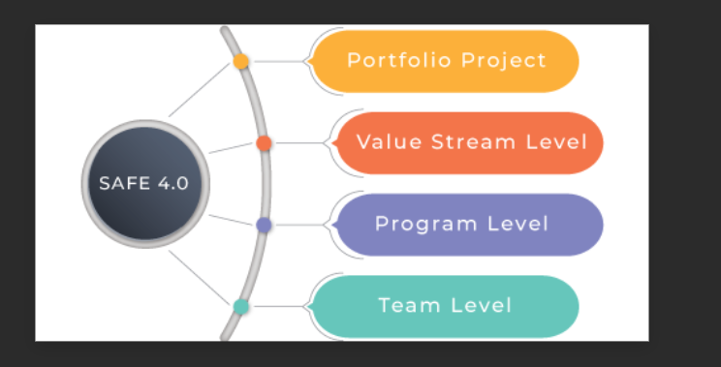
safe frame work

Slide 13
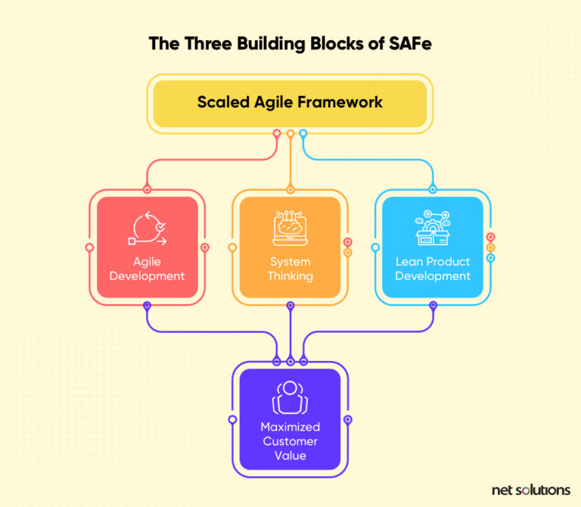
process

Slide 14
SAFe methodology can be applied in a variety of applications and scenarios, including
Large-Scale Software Development: SAFe is particularly useful for large-scale software development efforts that involve multiple teams, departments, and stakeholders. By providing a structured framework for collaboration and communication, SAFe helps to ensure that everyone is aligned on the project goals and working together towards a common objective
Enterprise-wide Agile Transformation: SAFe can also be used to drive enterprise-wide agile transformations. By providing a roadmap for agile adoption, SAFe helps to ensure that the transformation is planned and executed in a systematic and effective manner, with buy-in from all stakeholders

Slide 15
continuation
Cross-functional Teams: SAFe is ideal for cross-functional teams that require a high degree of collaboration and coordination. By providing a structured approach to planning and execution, SAFe helps to ensure that all team members are aligned on the project goals and working towards a common objective
Product Development: SAFe is well-suited for product development efforts, where multiple teams are involved in developing and delivering a product. By providing a framework for continuous delivery, SAFe helps to ensure that the product is delivered on-time and on-budget, with high quality

Slide 16
CONCLUSION
Overall, SAFe methodology is a versatile framework that can be applied in a wide range of applications and scenarios. Its structured approach to collaboration, planning, and execution makes it an ideal choice for large-scale software development, enterprise-wide agile transformations, cross-functional teams, product development, and agile project management

Slide 17

thank you

